Slide 1
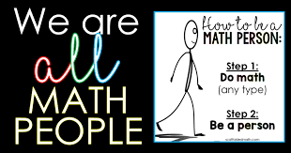
NBES Numeracy Parent Presentation

Slide 2
NBES Attribute Wheel
Focus on Belonging
How do we foster belonging?
Safe
Respected
Valued
Supported
Inclusive Community

Slide 3
Four quadrant details

Slide 4
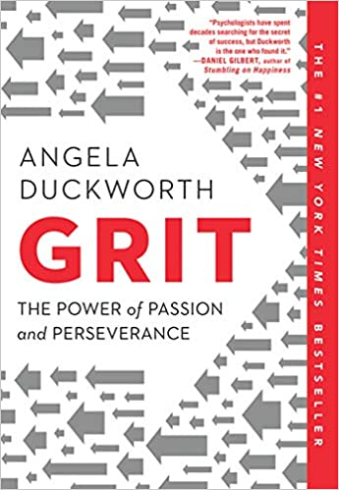
GRIT = perseverance + passion
Angela Duckworth – Psychologist
“Who is successful here and why?”
Perseverance and passion are most important indicators of success
TED Talks: Sylvia Duckworth GRIT: The Power of Passion and Perseverance

Slide 5
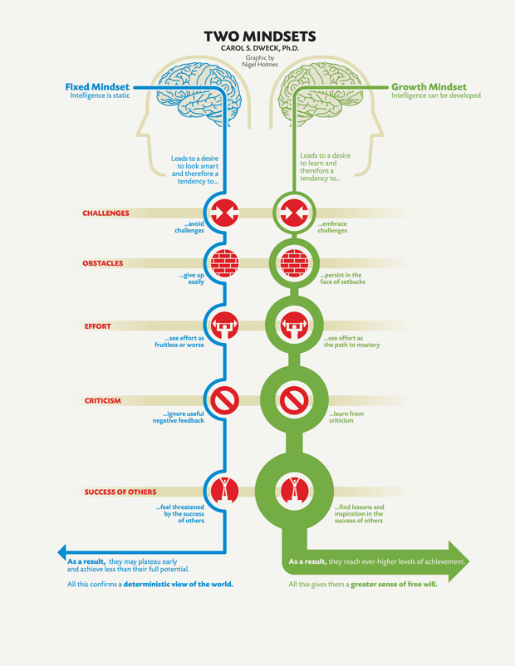
Growth Mindset = intelligence can be developed with effort and experience
Carol Dweck - Psychologist
When one has a growth mindset, one embraces challenge and sees effort and perseverance as the path to success.
The power of “yet”!
TED Talk: Carol Dweck: The Power of Believing That You Can Improve

Slide 6
The Positive Power of Struggle
Why Struggle is Essential for Our Brain and Our Lives
Neuroscience Behind Productive Struggle
Struggle is critical to mastery
Those that have struggled the most are the highest achievers
Mistakes are good for our brain
Expected, inspected, respected
If you are only doing what you already know how to do, you are not learning or growing your brain
“hard, fun” That feeling of ‘hard’ is the feeling of your brain developing, strengthening and growing”.
Self-regulation strategies for when one is feeling frustrated, tired, or defeated → develop stamina

Slide 7
Attitude of Parents and Teachers Matter
Numeracy is unique in our curriculum:
Poisoned relationship
“I hate math”
“I’m not a math person”
“This is not the way I was taught”
The attitude of parents/teachers impacts success of learner
Teachers/parents teach how they learned
The best support is encouraging a positive growth mindset and to “play” with numbers!
So, undoing and rebuilding our relationship is imperative
Dr. Jo Boaler – YouCubed
Parents' Beliefs About Math Change Their Children's Achievement
6 Ways to Support Your Child's Mathematical Development

Slide 8
What is Math? What one word comes to mind?
"Math is" video from Global Math Project
What Math is:
Rich dialogue
Collaboration
Curiosity
Perseverance
Problem-solving
Creative and flexible
Purposeful and contextual
What Math is not:
Human calculator
Fast – speed pressure, timed tests
One way to solve
One right answer
Rules and steps
Memorization – “students who took a memorization approach to mathematics were the lowest-achieving students in every country” (Boaler 2020)

Slide 9
B.C. Curriculum – Numeracy spiral
Goals of our Curriculum
Develop curricular competencies
Very similar across all areas in curriculum
If our goal is to develop “deep” we have to DO “deep”
Progression:
Concrete →Pictorial→ Symbolic
Manipulatives, pictures, models expected for all
BIG Ideas across the grades
Spiral
Same 5 areas
Revisit and build (developmental readiness)
Curricular Competencies across the grades
Same 4 big skill sets

Slide 10
Some KEY WORDS from the curriculum:
Concrete materials
Mental math strategies
Flexible
Estimate reasonably
Multiple strategies
Model and draw
Explain and justify
Make connections
What kind of tasks and learning experiences foster this?
7 x 6 =
42 =
X + Y + Z = 42

Slide 11
5 x 18 How do you see the problem?
The power of visualizing!
2/5 brain pathways are visual
Quantity – finger perception – critical for number sense
Connect different areas of brain
Visual representation + symbolic
Visual tasks are engaging!
“students are inspired by the creativity that is possible when mathematics is visual” Boaler,2020

Slide 12
Number Talks – A powerful way to surface and “catch” strategies to build upon
12 x 18
“Strategies are caught, not taught!”
A strong sense of number is imperative to developing strategies
The number and kind of experiences a person has impacts strategy development
“tools in your toolkit”

Slide 13
The power of models
Area model – a model with “legs” across the grades
Promoting Models
Mash Up Math! Area Models Explained

Slide 14
Goals:
Foster positive attitude and growth mindset – see math as creative and collaborative and a place for success for all
Develop structures, routines, practices that foster learning communities and belonging
Number Talks
Alternatives to worksheets
Mathematical Discourse
Rich tasks
Math Passports
Develop learners with a deep conceptual understanding and with lots of “tools in their toolkit”!
Develop NBES Grit – Problem-solving, Collaboration, Curiosity, Regulation through the kinds of learning opportunities students are immersed in

